Slide 1
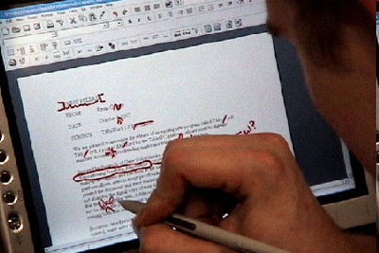
TAbiWord
Kevin Conroy
Dave Levin
March 11, 2004

Slide 2
Overview
Introduction
Motivation
Previous Work
Our Work
  PADD
  TAbiWord
Analysis
Future Work

Slide 3
Introduction
Despite widespread use of computers, paper still used extensively.
Benefits of Paper:
  Easy to annotate
  Fairly cheap and durable
  High-resolution display
Limitations of Paper:
  Expensive to duplicate and archive
  Markings made on paper are static and immovable (no way to transfer back to digital source)

Slide 4
Introduction (cont)
Digital word processing is widely used.
Benefits of digital:
  Change content and reflow text easily
  Easy to duplicate, search
Limitations of digital:
  Many people prefer to print documents for reading and proofreading/editing

Slide 5
Motivation
Augment paper interfaces while preserving the flexibility of digital document.
Ability to interact with documents via paper or computer (whichever is more convenient)
Ultimate Goal: Seamless integration of paper and computers

Slide 6
Previous Work
Tight coupling
  DigitalDesk [Wellner 93], Ariel [Mackay]
  A-Book [Mackay 02]
  PaperLink [Arai 97]
  Intelligent Paper [Dymetman 98]
Paper as input device
  Xax [Johnson 93]
  Anoto
  Paper PDA [Heiner 99], [Avrahami 01]
Digital emulation
  FreeStyle system [Wang 89]
  MATE [Hardock 93]
  XLibris [Schilit 98], [Golovchinsky 02]
PADD [Guimbretière 03]

Slide 7
Previous Work (cont)
PADD [03] and XLibris [02] seem to offer best solution
  Paper and digital sources are decoupled
    User can continue to use each in the manner in which they are familiar
  Supports digital marking and reflow
What’s missing?
  PADD [03] system lacks support for distributed use
  Document contents can’t change (only layout)

Slide 8
Our Work
Set of primitives that support transfer between paper and digital source
  PADD Infrastructure: Infrastructure for distributing storage of documents and annotations
  TAbiWord: Provide digital support for paper-based markings that are able to reflow as the document’s content, structure, or layout changes

Slide 9
PADD Infrastructure
Four use cases
 | Single version | Multiple versions
Single user | Print, annotate | Print, annotate, update digitally, print again
Multiple users | Multiple printings, multiple annotations | Multiple printings, multiple annotations, updates made digitally, selective reprints

Slide 10
PADD - Motivation
Single user – single version
  Immediately able to do
Single user – multiple versions
  Need a way to map strokes to documents
Multiple user – single versions
  Need a way to map users to strokes
Multiple users – multiple versions
  Need a way to provide file permissions

Slide 11
PADD Database
Maps strokes to documents
Maps users to strokes
Maps files to file stores (FTP, …)
Records all events
  Printings
  Strokes storing
Map users to files and events
Provides a standard interface to the data
  PADD Server API
  Clear DB design
Remains protocol-independent
  Paper
  Editor

Slide 12
PADD DB Client
Need to inform the database when documents are printed
Who knows when this happens?
  Editors (Acrobat, TAbiWord)
  Printer drivers
Clients are very thin
  7 different operations to support
    Editors need only 3 of these
  Library available

Slide 13
PADD DB - Limitation
PADD Database solves the issues for all use cases
Does not scale
  All printings and annotations at one database?
Need a way to distribute the load
  Clear delineation: paper distribution
    Anoto sells page ranges (28.0.47.0 – 28.0.47.127)

Slide 14
PADD Directory
Each database is responsible for a given (set of) page ranges
  All printings and annotations
  Database per administrative domain
PADD Directory
  Similar to DNS
  Provides the mapping from page address to administrative domain (PADD DB)
Databases remotely accessible

Slide 15
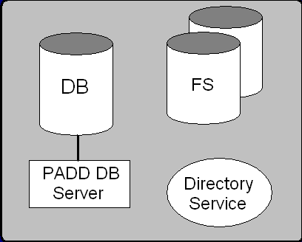
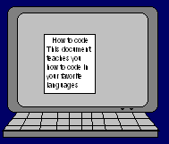
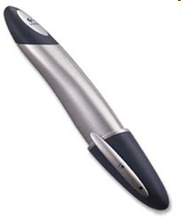

Slide 16
1. Locate the DB

Slide 17
1. Locate the DB
2. Store the info

Slide 18
1. Locate the DB
2. Store the info
3. Store the files

Slide 19
Distributed DBs - Results
Distributing the PADD infrastructure brings about:
  The desire to store files in a distributed way
  A decoupling between paper and digital
    Manual distribution still allows digital access
  The ability to employ orthogonal file processing
      Asynchronous “strokes collectors”
      CVS
  The need for file permissions
  A peering of the servers

Slide 20
File Processing
Strokes collector
  Incorporates a given strokes file and document
Would like this to happen asynchronously
  Save time
    Large documents
    Complex incorporation (doesn’t have to be so straightforward)
    Cache results

Slide 21
Notification System
General scheme: notifier and subscriber
DB Server knows when events happen
Strokes collectors can be separate processes that subscribe to events

Slide 22
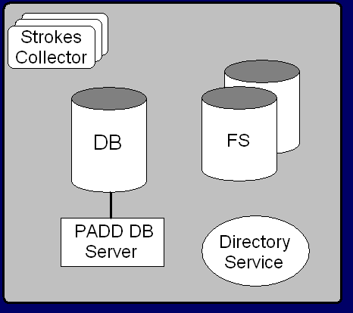

Slide 25
Notification System (cont)
Other processes can subscribe to events
  Authors of documents
    When are annotations made
    When are documents printed
  Annotators of documents
    Auto-open documents digitally once annotated
      Having one sheet of a physical copy gives you access to the document digitally

Slide 26

TAbiWord
Extension of AbiWord (www.abiword.org) with support for digital annotation and reflow
Addresses issues raised by XLibris [02] as well as issues of digital reflow in documents with dynamic content

Slide 27


Ink Source
Mouse, WACOM, Tablet PC stylus
PADD system allows for paper-based annotations
Allows users to select the annotation interface most appropriate for their task

Slide 28
Ink Association
Determine context in which annotation is made
Semantic meaning of the mark must be preserved
Focused on ANSI standard proofreading marks
  Contextually associated with a single letter or word
  Drawn over several words or lines

Slide 29

Ink Association (cont)
Determine sharpest change in direction
  Law of Cosines + Sliding Window (size >= 13)
Associate with text that overlaps this point
(Insertion point denoted by blue circle.)

Slide 30
Ink Storage
Store ink directly in document
Digital reflow more efficient
Allows document’s content to change

Slide 31
Ink Reflow
Ink must stay with semantically correct text during layout
Content changes (e.g. add/delete text)
Formatting change (e.g. margins/font size)
Zooming and scrolling

Slide 32
Ink Reflow (cont)
Each stroke saves initial location in layout
Stroke stored as a document element
  Layout engine will process it in as it renders semantically correct text
When stroke redrawn by layout engine, check to see if position has change and translate to appropriate position

Slide 33
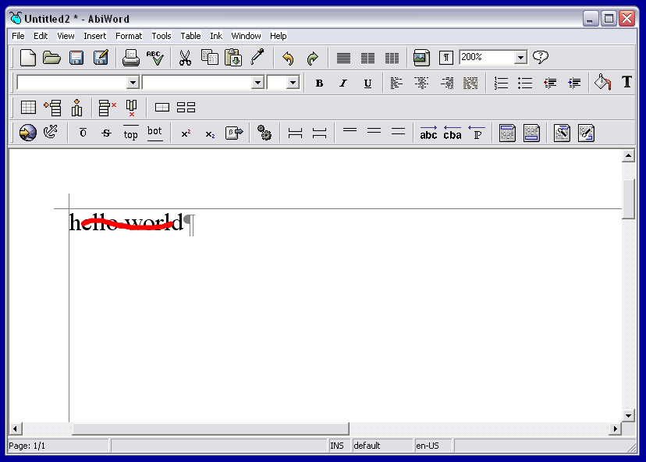
Before Reflow: Initial content with annotation

Slide 34
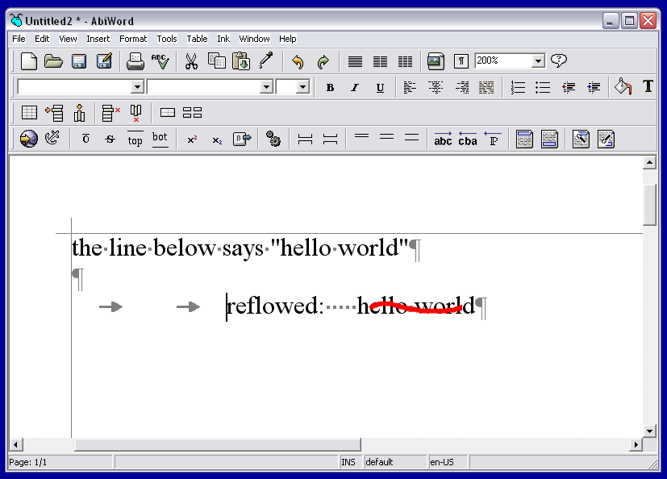
After Reflow: Initial content plus changes

Slide 35
Ink Clipping
Some markings are large (e.g. cross out mark)
After reflow, semantic text may span two or more lines
Break up large strokes into smaller strokes which are associated with semantically correct text
  Clip stroke to non-hyphenable words
Allows reflow across multiple lines

Slide 36
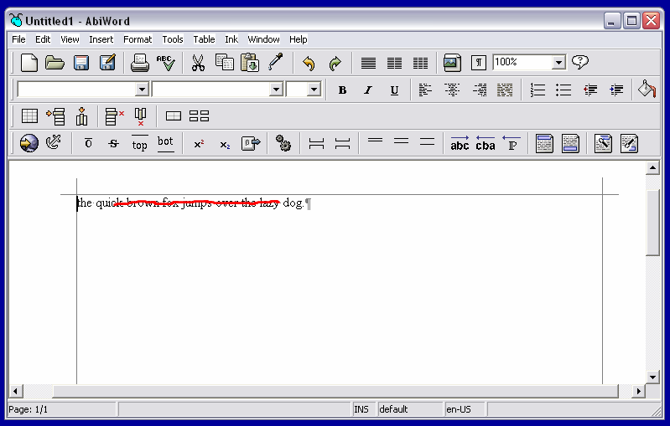
Before Reflow: Initial content with annotation

Slide 37
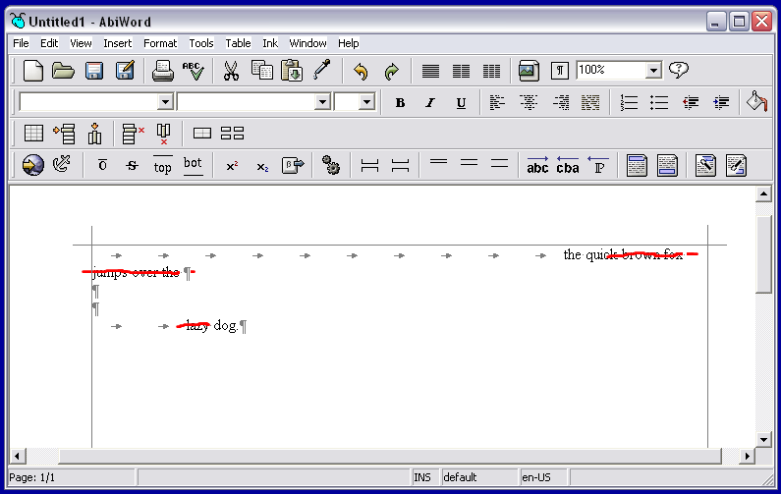
After Reflow: Initial content clipped over several lines

Slide 38
Analysis
Recall our ultimate goal: Seamless integration of paper and computers
Bridge between paper & computer
  Users able to print documents and interact in a familiar, natural manner
  Markings translated automatically from paper to computer
  Digital reflow allows users to continue editing and writing process on the same revision

Slide 39
Future Work
PADD
File permissions
  Varying granularities (private annotations)
Exploit peering of the servers
  Many existing peer-to-peer benefits
    Redundancy, censorship resistance, etc.
Solve the paper problem
  Finite set of paper – how to deal with page address collisions?
Caching at the client
  Remove the assumption that a connection to a server always exists

Slide 40
Future Work (cont)
TAbiWord
Additional work needs to be done to support reflow of freeform annotations
Users have expressed interest in automated correction/application of proofreading markups
  Limited by accuracy of handwriting recognition engine

